Slide 1

Coding Workshop Datatypes II
23.02.2026
Melissa Franke

Slide 2

Recap - Datatypes I – simple Datatypes
All variables are stored in RAM -> RAM is temporary storage (and limited)
It is good practise for variable names to make sense
Variables are assigned as name = value
Simple datatypes:
Boolean – False or True
Integer – whole numbers
Float – real numbers
Char – characters
String – combinations of characters
Typing conventions:
Duck typing – assigns data type by value and operator – may create errors
Typecasting:
Convert one datatype into another
Statements:
Programming logic is created by combining Boolean statements
Comment your code by using the character #
Increasing complexity,
Increasing memory consumption
Coding Workshop
Datatypes II
Melissa Franke
M.Sc
0

Slide 3
Complex Datatypes - List
Values of a List are multiples of one Datatype sorted in order
Can be used to:
store data of the same type
Store data of different types
manipulate data
Can be 1-, 2-, 3- or n-dimensional
lists in python are similar to arrays in other languages
Coding Workshop
Datatypes II
Melissa Franke
M.Sc
1

Slide 4
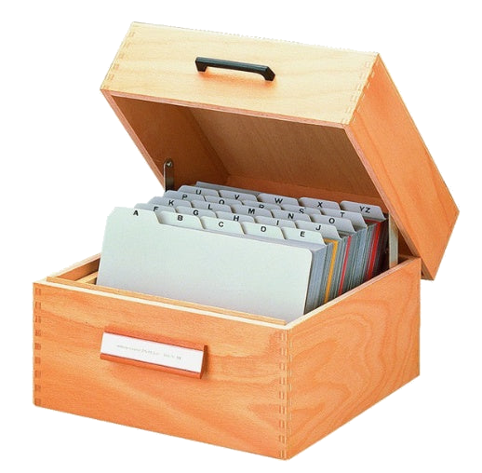
Complex Datatypes - List
Thought example: from index box to archive
Dimension=1
first card: Aach
second card: Aachen
third card: Aalen
…
last card: Zellah-Mehlis
index = city
Index box of all cities in Germany
Coding Workshop
Datatypes II
Melissa Franke
M.Sc
2

Slide 5

Complex Datatypes - List
Thought example: from index box to archive
Dimension=2
first row, first card: Aalst
first row, last card: Zoutleeuw
second row, first card: Aach
second row, last card: Zellah-Mehlis
…
indices = country, city
Filing cabinet of cities in Europe
Coding Workshop
Datatypes II
Melissa Franke
M.Sc
3

Slide 6
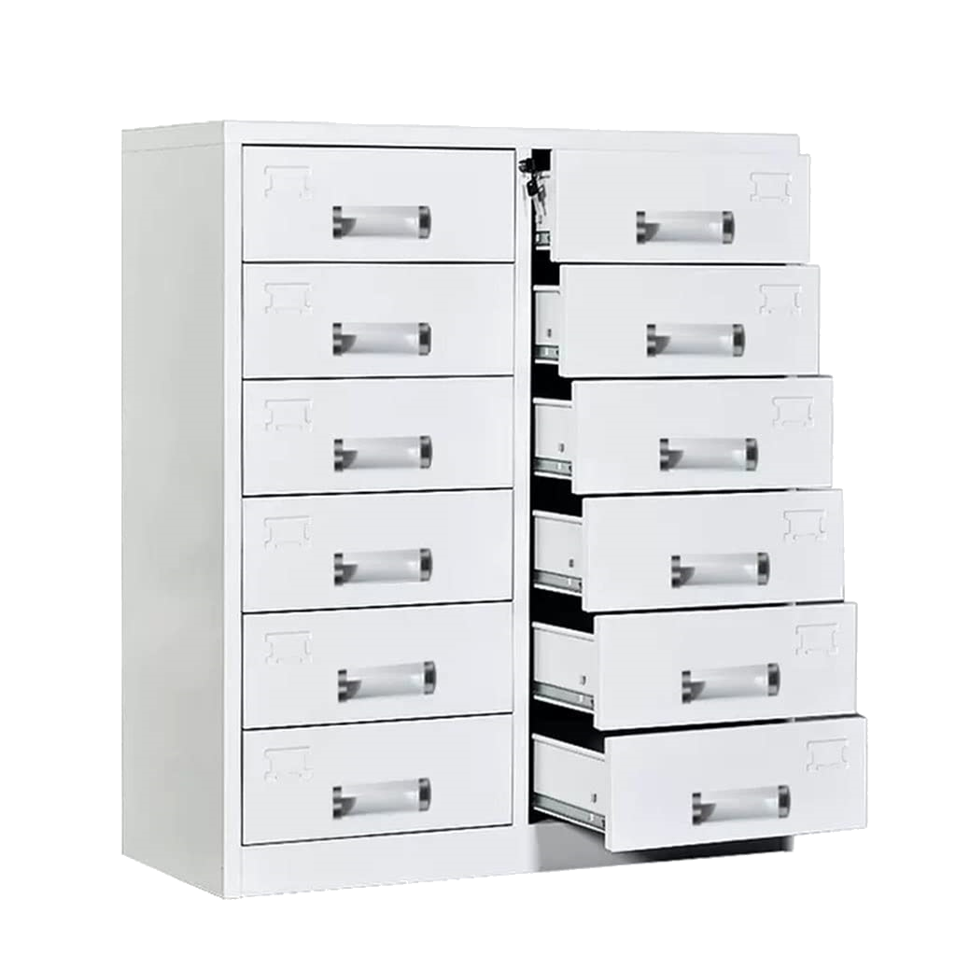
Complex Datatypes - List
Thought example: from index box to archive
Dimension=3
first row, first column, first card: Aalst
first row, first column, last card: Zoutleeuw
…
indices = continent, country, city
Filing cabinet of cities of all continents
Coding Workshop
Datatypes II
Melissa Franke
M.Sc
4

Slide 7

Complex Datatypes - List
Thought example: from index box to archive
More and more dimensions possible, but path to information is always clear
indices = planet, continent, country, city
Room with all cities of different planets in the solar system
Coding Workshop
Datatypes II
Melissa Franke
M.Sc
5

Slide 8
Complex Datatypes - List
List in python:
1D is called list, higher dimensionality: list of lists
A list is iterable, meaning it can be sequentially moved through
Every element has a position, called index
A list starts always at position 0!
Elements can be excised, inserted, appended, sorted, …
Coding Workshop
Datatypes II
Melissa Franke
M.Sc
6

Slide 9
Complex Datatypes - Dictionary
A Dictionary is used to keep data attributes together
Can be used to store:
Data of different types
contextual data
Has a name, keys and values
Coding Workshop
Datatypes II
Melissa Franke
M.Sc
7

Slide 10
Complex Datatypes - Dictionary
Dictionary example:
Coffee Pads:
strength: 3
taste: 5
Has stones: False
beans: [Arrabica, Robusta]
owner: Melissa
Schümli Coffee:
strength: 3
taste: 4
Has stones: True
beans: [Robusta, Arrabica]
owner: Chemosensation Lab
Coding Workshop
Datatypes II
Melissa Franke
M.Sc
8

Slide 11
Questions?

Slide 12
Datatypes II - Exercises
Hints:
my_list = list()
my_list = [a, b, c, …, z]
len(x)
my_list.sort()
my_list.append(x)
my_list.pop(x)
my_list.index(x)
my_list.remove()
my_list.insert(x)
Exercise 1: create, access, manipulate
1. Create a list containing the following integers:
1, 10, 9, 7, 8, 6, 2, 3, 4, 5
2. Without coding, what is the number at indices:
3, 6, 0
3. Sort the list. Get the index of value 10
4. What is the length of the list?
5. Delete the value at index 3. What is now at index 3?
6. Add the deleted value back in
7. Print the numbers at indices 3, 6 and 0
8. Replace the last value with 9000
Coding Workshop
Datatypes II
Melissa Franke
M.Sc
9

Slide 13
Datatypes II - Exercises
Hints:
my_list = [a, b, c, …, z]
Exercise 2: indexing ranges
Create a list with the following values:
0.1, 2.3, 3.5, 4.6, 5.2, 6.9, 7.4, 8.1, 9.0, 9000.9
Try print(my_list[2:4])
Try print(my_list[:4])
Try print(my_list[2:])
Try print(my_list[:])
What does the ‘:’ character do? What are its rules?
Try print(my_list[0:len(my_list)])
Try print(my_list[::2]) What happens?
Try print(my_list[2:4:2]) What are the rules?
Coding Workshop
Datatypes II
Melissa Franke
M.Sc
10

Slide 14
Datatypes II - Exercises
Hints:
my_list = [a, b, c, …, z]
Exercise 3: indexing quirks
Create a list with the following values:
1, ‘Alt+Tab’, 3, 4.5, True, 6, ’g’, 8, 9, 9000.0
Try print(my_list[0])
Try print(my_list[1])
Try print(my_list[-1])
What does a negative index do?
Using your vast indexing knowledge, print all values from the second to last value to the end.
Coding Workshop
Datatypes II
Melissa Franke
M.Sc
11

Slide 15
Datatypes II - Exercises
Hints:
my_list = [a, b, c, …, z]
my_list = list()
my_list[a] = x
my_list[a][b] = x
Exercise 4: more dimensions
Create a list with these values: 1, 2 ,3
Create another list with these values: 4, 5, 6
Create another list with these values: 7, 8, 9
Create an empty list and append list1 and list2
Print this list and look how it is structured.
Copying this structure, create a list of all three lists
Try to navigate this 2D list. Find a way to print the values 3, 6, 4, 5 and 7
Coding Workshop
Datatypes II
Melissa Franke
M.Sc
12

Slide 16
Datatypes II - Exercises
Hints:
my_list = [a, b, c, …, z]
my_dict = {‘key1’ : value, ‘key2’ : value, …}
Exercise 5: list of dictionaries
Create an appropriate datastructure for the following scenario:
A dance school wants an overview on new applicants. Three people have applied for a dancing course.
Rob is 32 years old, has a dance partner, but no previous dancing knowledge. Catherin is alone, 27 years old and has danced for two years. Clara is also 27 years old, has a dance partner, and 10 years experience.
Coding Workshop
Datatypes II
Melissa Franke
M.Sc
13

Slide 17
Datatypes II - Exercises
Hints:
my_list = [a, b, c, …, z]
my_dict = {‘key1’ : value, ’key2’ : value, …}
my_dict.get(‘key1’) my_list.pop(x)
my_list.insert(x)
Exercise 6: handling combined datatypes
The dance school wants to compare all ages of the applicants. Do they have the same age?
The dance school wants to know if applicant 3 has a dance partner.
“Catherin” has contacted the dance school, as she has made a typo. Her name is actually Catherine. And she has a dance partner. Delete her entry and replace it with the corrected one.
The course is only for experienced dancers. Delete all applications that do not fit.
Coding Workshop
Datatypes II
Melissa Franke
M.Sc
14

Slide 18
Cheat Sheets and Vocabulary

Slide 19
Datatypes II - cheat sheet
More complex Datatypes combine simple Datatypes for easier/ more comfortable data access
Most of the time less performant than the simple Datatypes it consists of.
lists:
Can have more than one dimension
Element positions are called indices and start at 0
Elements can be of the same or different datatypes
Can be iterated
Dictionaries:
Are mostly used to store contextual information
Are made of keys and values
Can store elements of same or different datatype
Coding Workshop
Datatypes II
Melissa Franke
M.Sc
14

Slide 20
Datatypes II – Python Vocabulary
Array declaration:
my_list1=list()
my_list2=[a, b, …, z]
my_2d_list=[[a,b,c][d,e,f]]
list access:
1D: my_list[a]=x
2D: my_list[a][b]=x
3D: my_list[a][b][c]=x
list functions:
.append() .insert() .sort() .index()
.count() .pop() len(x) .remove()
Dictionary declaration:
my_dict={‘key1’ : x, ’key2’ : y, ’key3’ : z}
Dictionary functions:
.get()
.items()
.keys()
.values()
.update()
Coding Workshop
Datatypes II
Melissa Franke
M.Sc
15

